Slide 1



MINOR PROJECT
Project Name- Fake AI Voice Detection System
Semester- 6th A2
Team Members:
Varenya Sharma (2021a1r081) –[LEADER]
Alok kitchloo ( 2021a1r067)
Rachna Sharma (2021a1r078)
Model Institute of Engineering & Technology

Slide 2



Team Members
Leader
Group member
Group member

Slide 3
Table Contents
Project Objective
Problem Solution and Statement
Technology Stack
Random Forest
Flowchart Making
Implementation

Slide 4
Project Objective and Outcome
Objective:-
The project outcomes for fake AI voice detection include the development of a highly accurate detection algorithm, the creation of a comprehensive voice dataset, and the establishment of a real-time analysis system with user-friendly interfaces.
3

Slide 5
Problem Statement: Detecting fake AI-generated voices poses a significant challenge due to the increasing sophistication of synthetic voice generation technology, leading to potential misuse for fraud and misinformation.
Problem Solution:
Spectral analysis with Mel-frequency capstral coefficients (MFCCs) and classification of Support Vector Machines(SVMs) with the help of Python, Librosa and scikit-learn.

Slide 6
Technology Stack
Language Used: Python
Algorithms Used: Random Forest
Libraries Used: NumPy, librosa, scikit-learn, customtkinter

Slide 7
How Random Forest Work?
Random forest is a popular machine learning algorithm that falls under the category of ensemble learning. It works by constructing multiple decision trees during the training phase and outputting the average prediction of the individual trees.
To use random forest for fake AI voice detection, one would first need to collect a dataset of voice recordings that include both real human voices and synthetic AI-generated voices. The dataset would be preprocessed to extract relevant features from the audio, such as pitch, intensity, duration, and spectral features.
During the training phase, the random forest algorithm learns to distinguish between the features of real human voices and synthetic voices by building a set of decision trees that collectively make predictions based on the input features.
Each decision tree is built by selecting a subset of features and a subset of the training data, resulting in a diverse set of trees that collectively form the random forest.

Slide 8
Once the model is trained, it can be used to classify new voice recordings as either real or fake AI-generated voices. The model evaluates the input features of a new voice recording and passes it through each decision tree in the random forest.
By using random forest for fake AI voice detection, one can effectively identify synthetic voices and distinguish them from real human voices. This can be valuable in various applications where the authenticity of voice recordings is crucial, such as in fraud detection, voice-based authentication systems, and voice message verification.

Slide 9
How MFCCs Works?
Initially, the audio signals undergo preprocessing, ensuring they are in suitable formats for analysis, including steps like resampling and noise removal. The signals are then divided into short frames, typically around 20-30 milliseconds each, with some overlap for detailed temporal analysis. Each frame is multiplied by a windowing function to reduce spectral leakage. Next, the Fourier transform is applied to each framed signal, converting it from the time domain to the frequency domain. Following this, the frequency spectrum undergoes Mel filtering, focusing more on human auditory perception by using filters spaced out in the mel-scale.

Slide 10
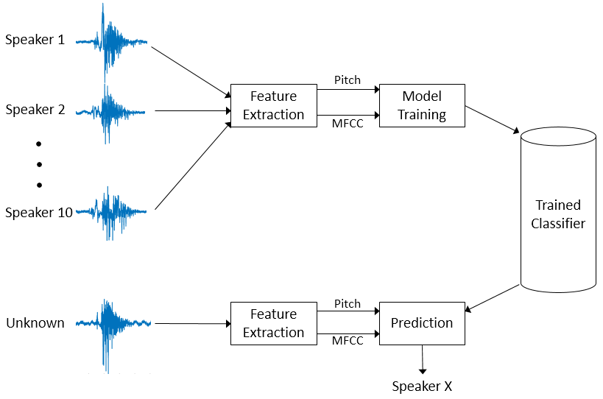
How MFCC Works?

Slide 11
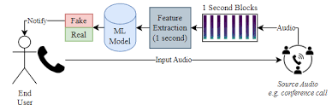
Flowchart Making

Slide 12
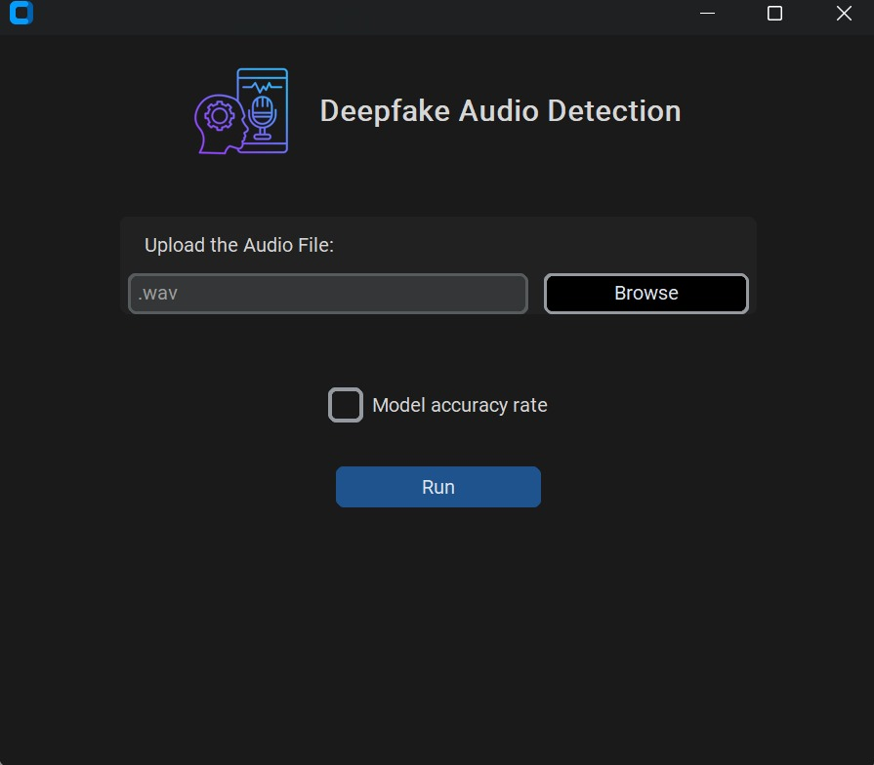
Implementation

Slide 13

Thank You

